Slide 1




Bridging the Gap Between STEM Professionals & “Everyone Else”
By: Kylianne Chadwick
Mentored by Daniel Stolte
University Communications
Arizona Space Grant Statewide Student Research Symposium
April 22, 2023

Slide 2
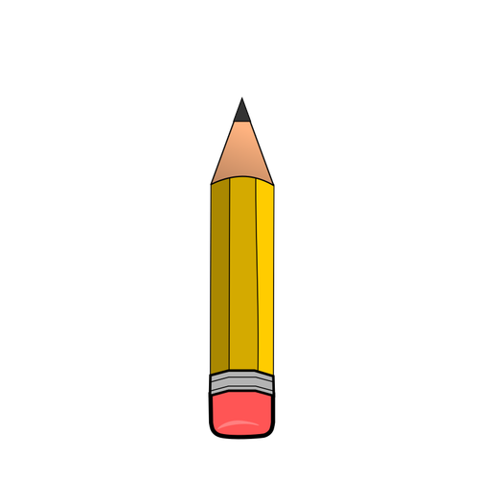



Context
Objectives
UArizona ranks among top public research institutions
However, public awareness of the research often lags behind
How do we engage a wide audience with complex science and technology research?
Interview researchers
Publish a variety of articles about UArizona research
Use creative headlines & introductions, quotes from researchers, simple language, vivid pictures & multimedia

Slide 3
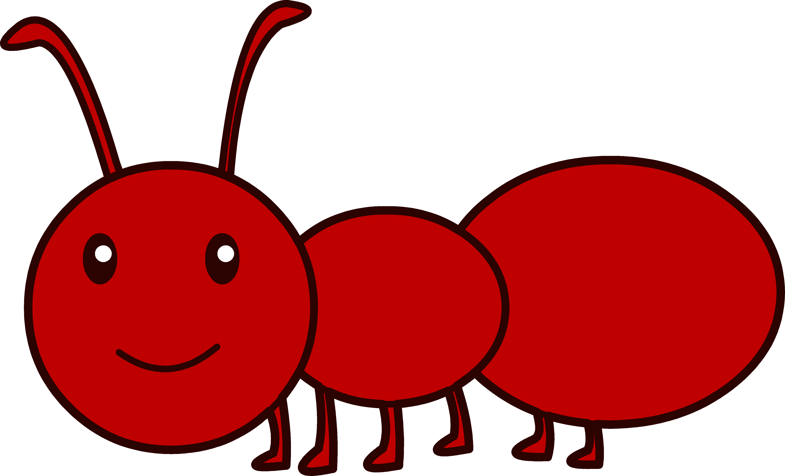
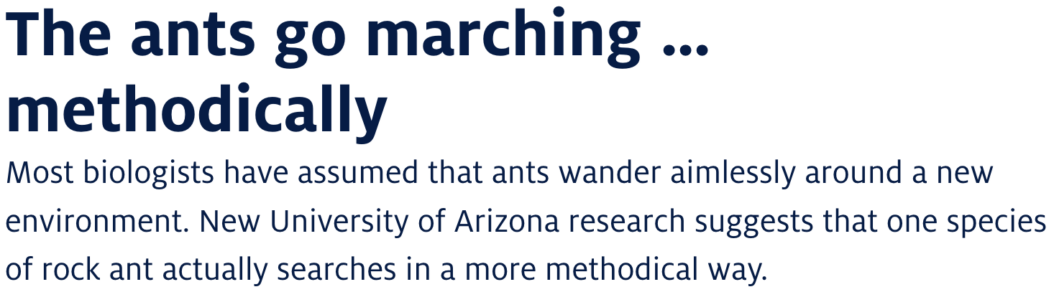
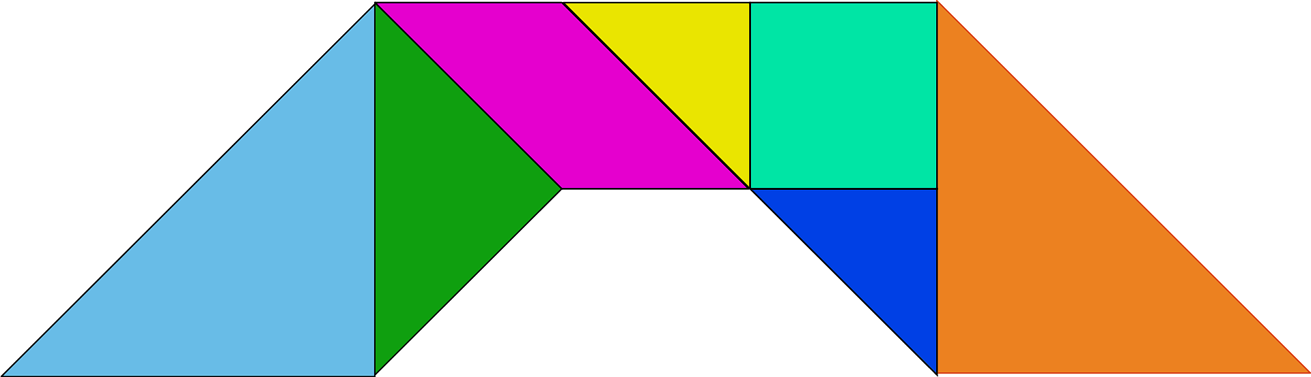
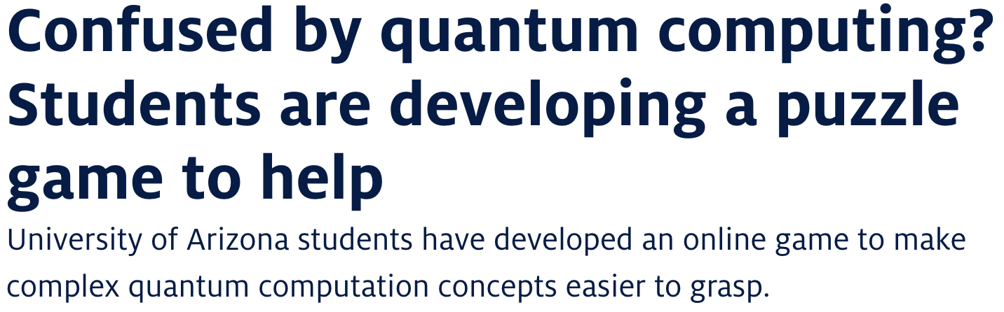
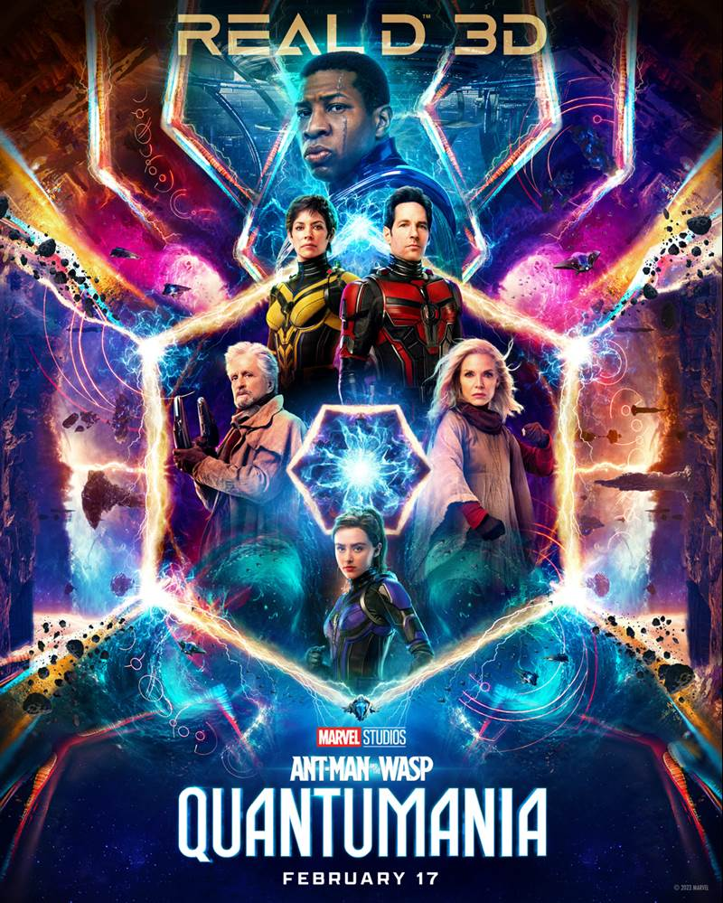

Headline & Introduction
Relate to the audience
Simplify concepts that are hyper-specific or confusing
Make science interesting & less intimidating

Slide 4
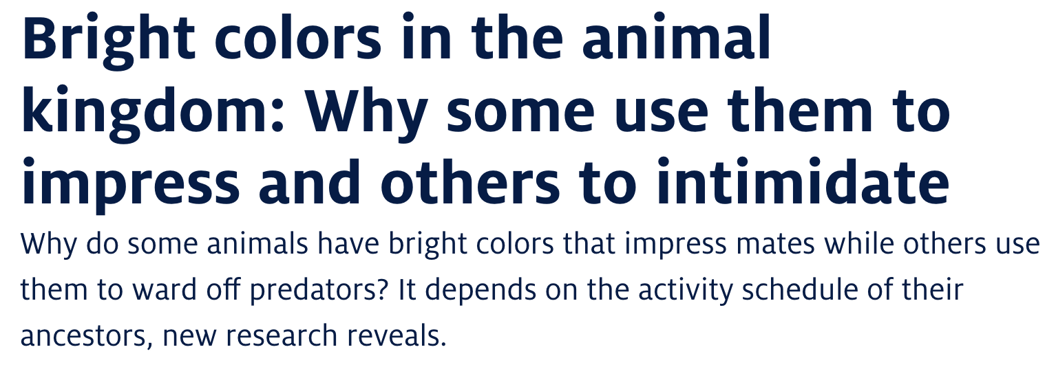
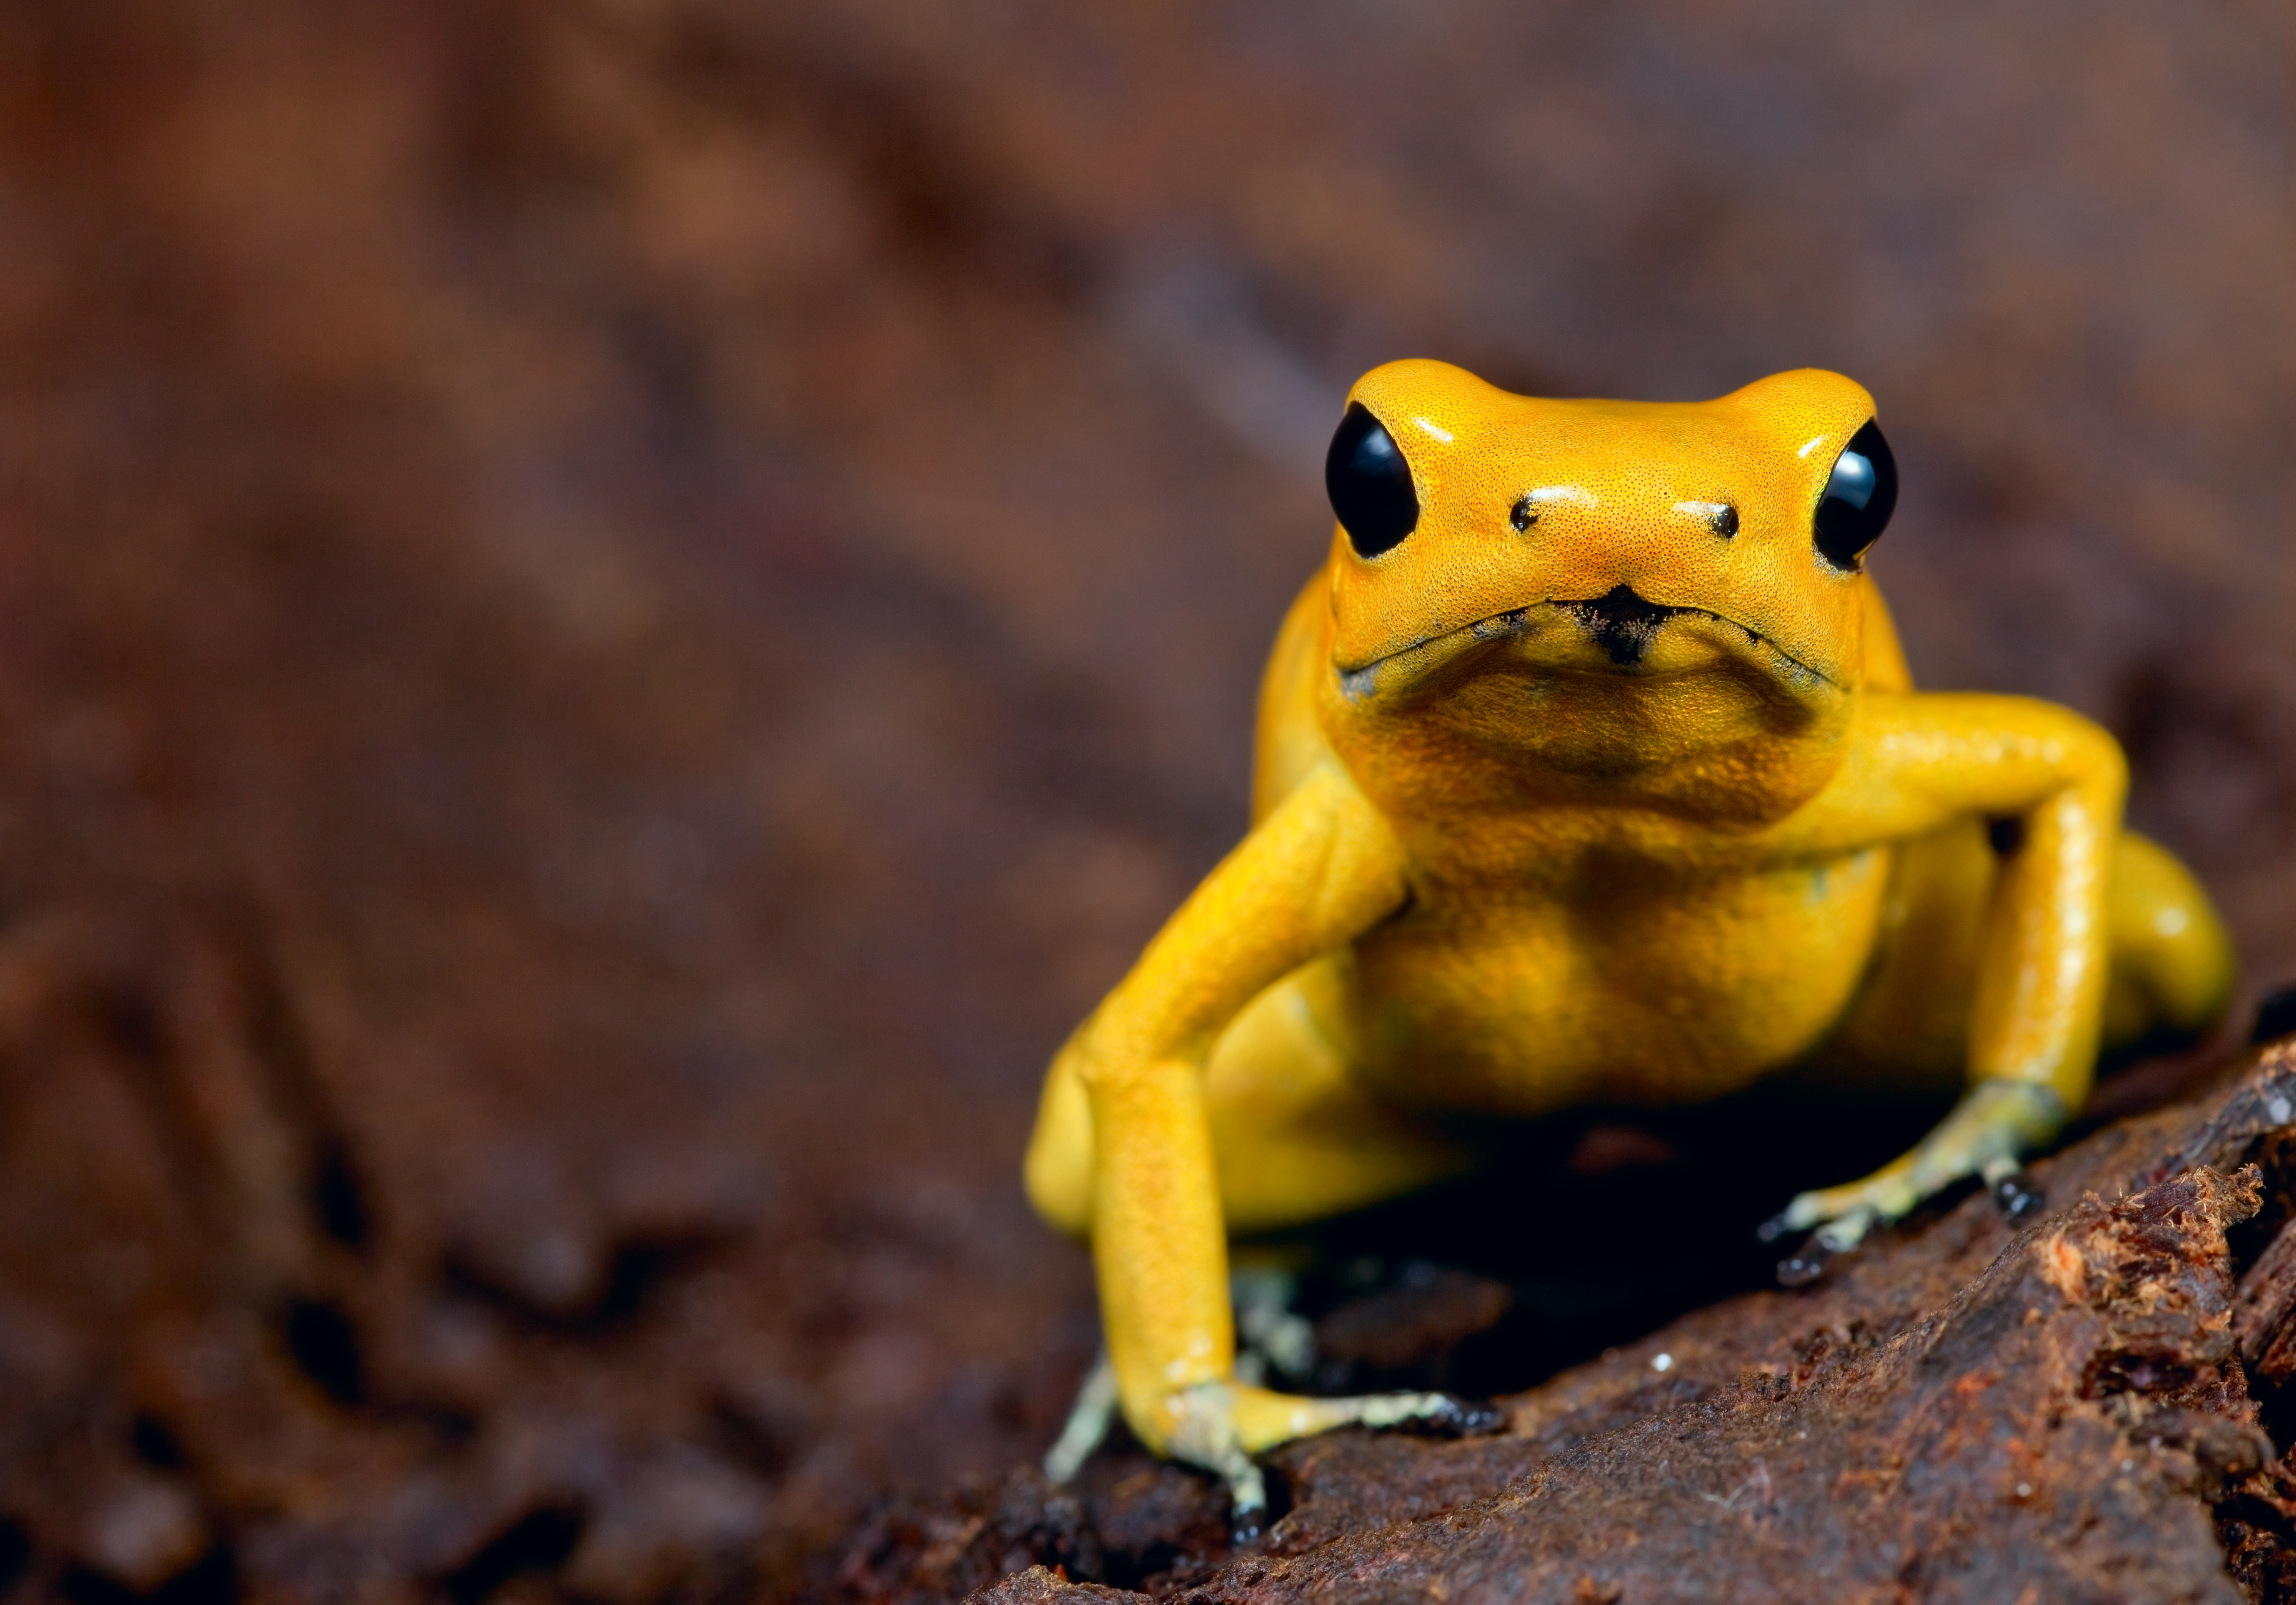
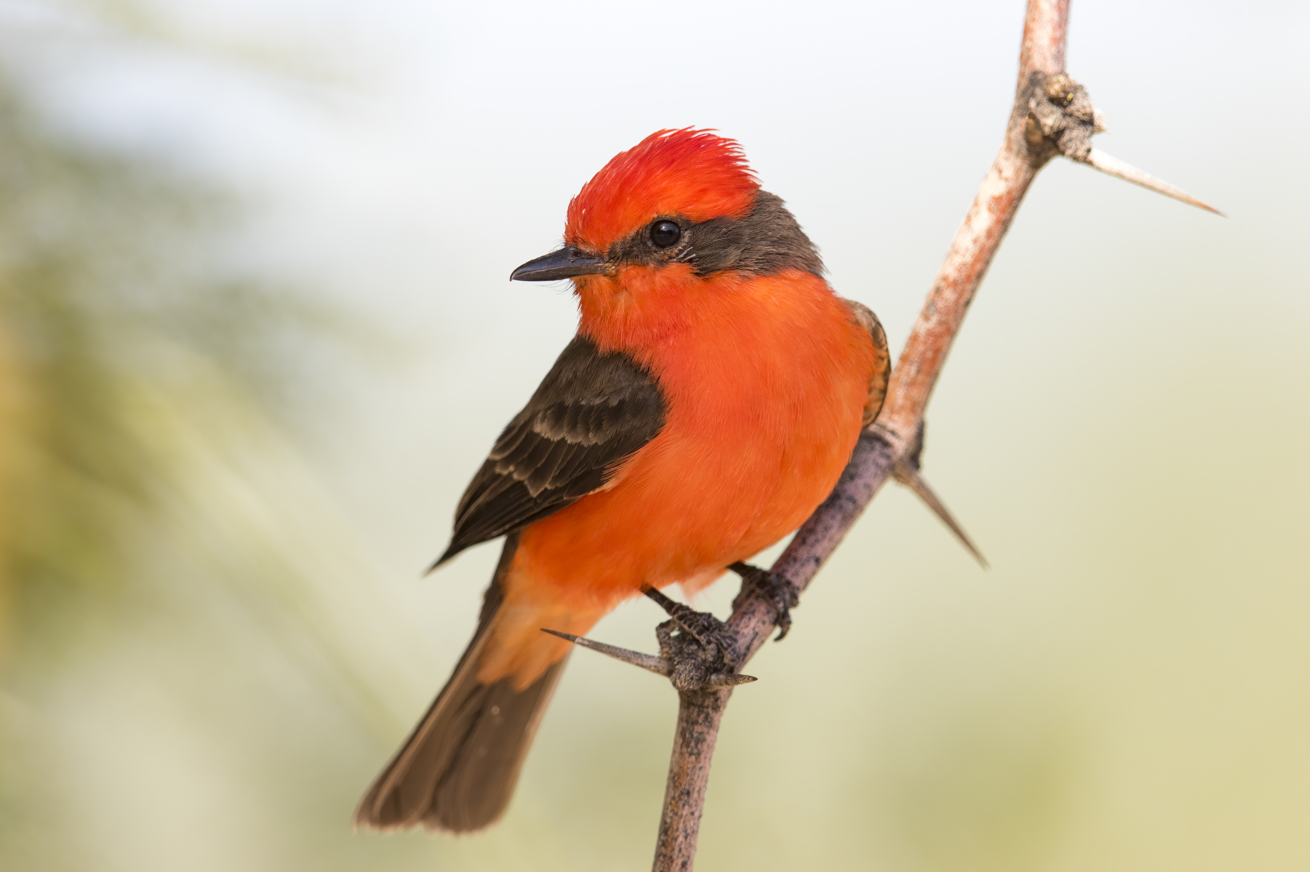
Story Content
Ask scientists questions & choose compelling quotes
Incorporate background information & transitions with simple language
Dive deeper with vivid pictures & captions
Reiterate many versions with researchers & editor
Credit: Da Vinci Science Center
Credit: Mick Thompson via Flickr

Slide 5
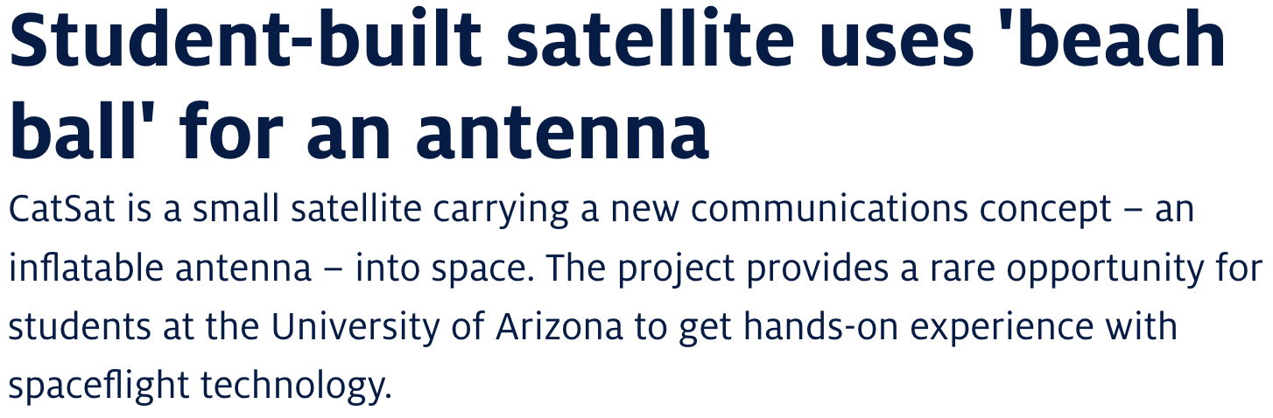
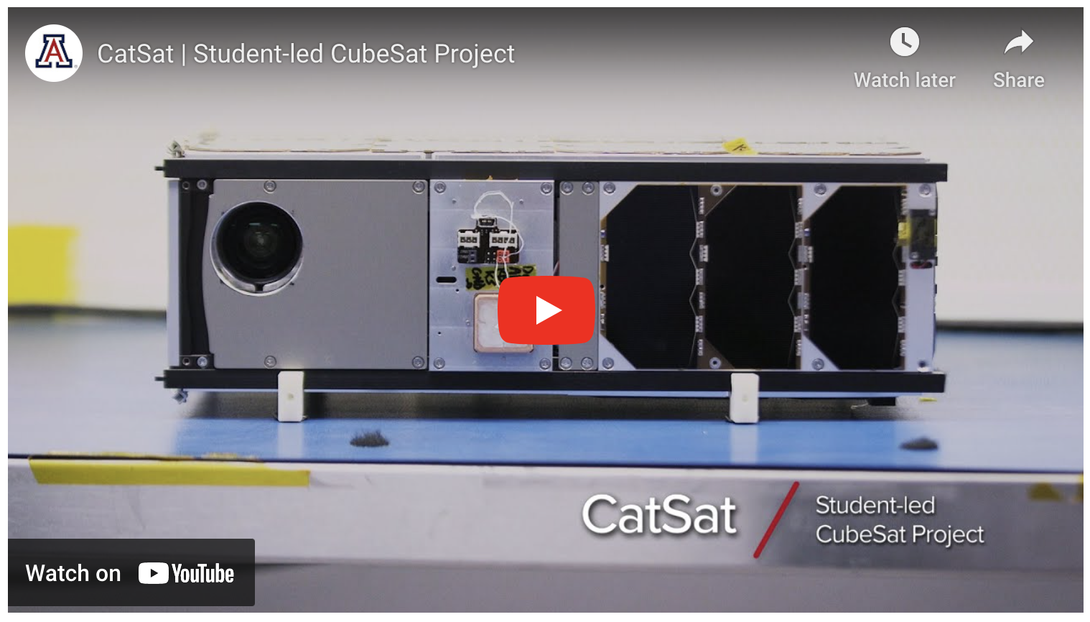
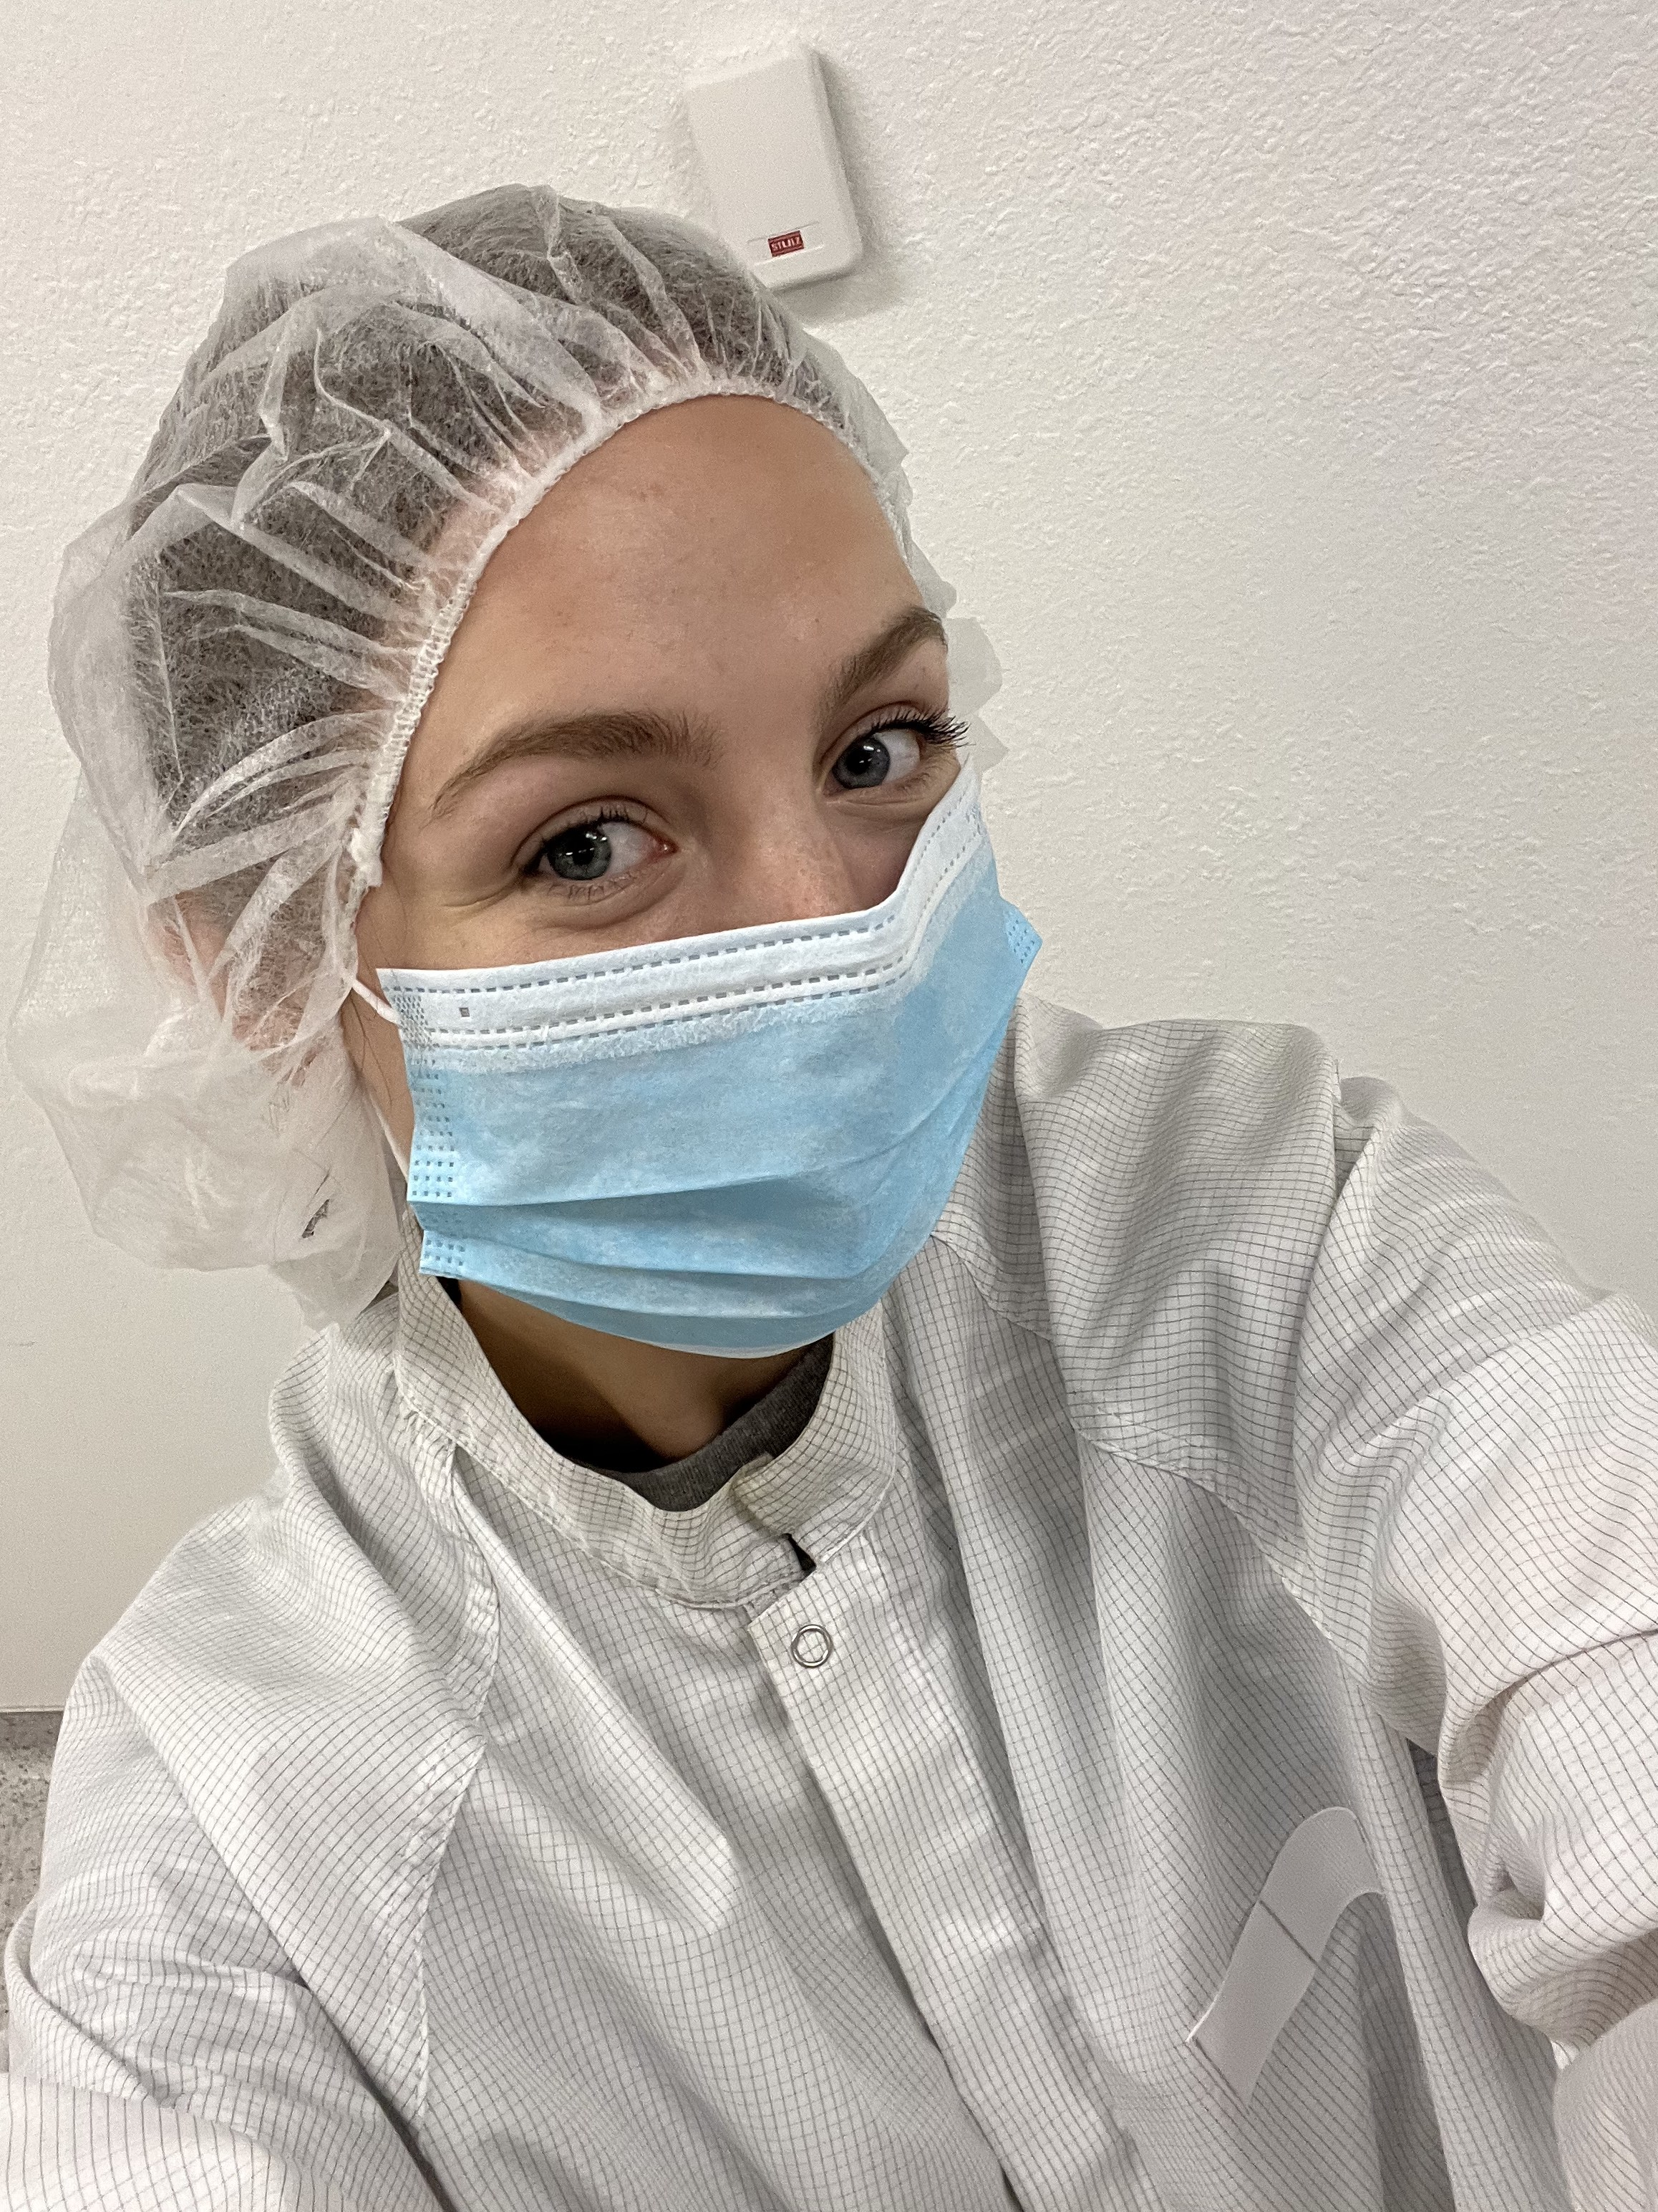
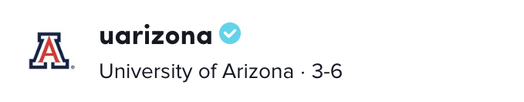
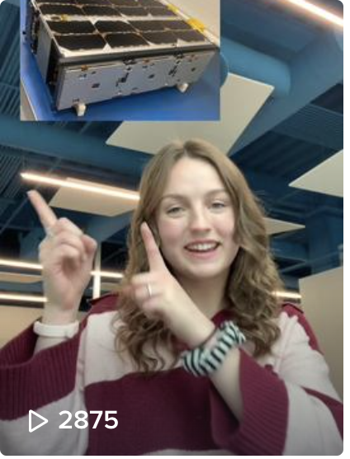
Multimedia
Reach a wider audience
Interact with media/video experts & research teams

Slide 6
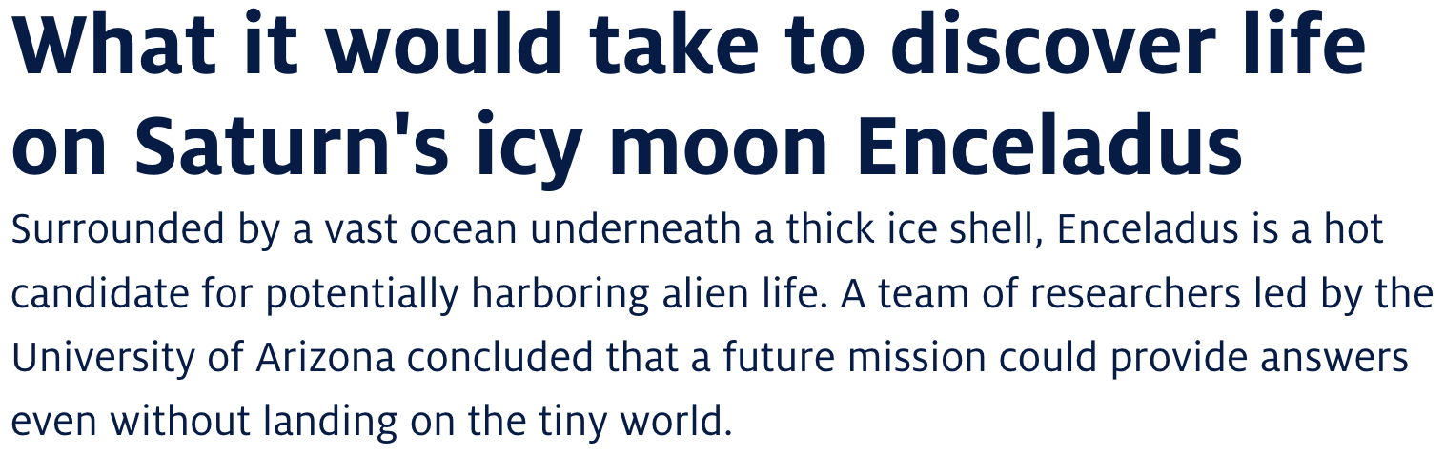










Results: Media Coverage
Published content on UANews, social media & other sites
Earned media coverage from outside reporters
Popularized scientists & their research among STEM amateurs & professionals

Slide 7
Acknowledgements
I thank my mentor, Daniel Stolte, for supporting and challenging me throughout this internship. It has also been an honor to meet and work with others in University Communications.
I also acknowledge NASA Space Grant & its local directors for organizing this internship and giving me the opportunity to participate in activities that were truly engaging.

Slide 8
Thank You!

